Slide 1
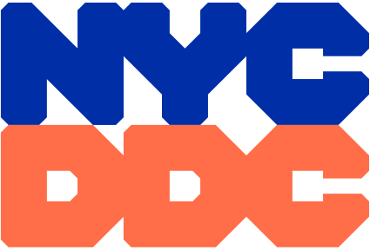
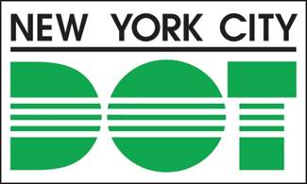
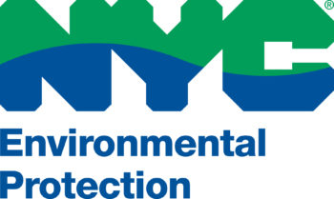
Inwood 10th avenue
safety improvements
PROJECT ID: hwm10inwd/SEN20008
BOROUGH OF Manhattan
MANHATTAN COMMUNITY BOARD 12 - TRANSPORTATION COMMITTEE MEETING
Zohran K. Mamdani
Mayor
Mike Flynn
NYCDOT Commissioner
Lisa Garcia
NYCDEP Commissioner
Eduardo N. del Valle, AIA, LEED AP, DBIA
Acting Commissioner
March 2, 2026

Slide 2

Agenda
Welcome
Project Location
Project Background
Project Goals
Existing Site Conditions
Proposed Improvements
Proposed Street Elements
Tentative Project Schedule
Community Liaison involvement
Questions / Open Discussion

Slide 3
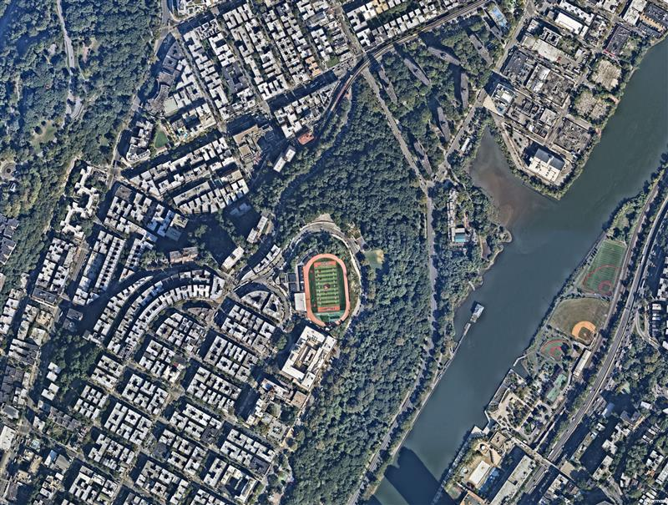
PROJECT Location
Fort Tyron
Site Three / Site Four
Inwood and Fort George Northern Manhattan, NY
Highbridge Park
Sherman Creek
Site One: Fort George Multisite
Site Two: Harlem River Drive Gateway
Site Three: Dyckman Rest Intersection
Site Four: Nagle Avenue El-Space Urban Design Corridor
Site Two
PS5
Roberto Clemente State Park
Site One
3

Slide 4
PROJECT Background
Site History
2012 – Fort George Ave. & Audubon Ave. Street Improvement Projects
Sidewalk & curb expansions
2018 – Inwood Rezoning
2023 – 10th Ave. Pedestrian Bridge Removal
2024 – Pedestrian Ramp Upgrades at 10th Ave.
Inwood NYC Action Plan delivered $200 million of public investments for neighborhood preservation
Shifting focus to street-level safety improvements
New traffic signal and crosswalk installed at former bridge site
Traffic signals upgraded along 10th Ave.
New school safety signage installed
2017 – Dyckman St. Protected Bike Lane Installation
2017 – Dyckman Rest Intersection Upgrades
Protected bike lanes added on Dyckman St.
Painted curb extensions added on 10th Ave. to improve safety and calm traffic
Ped ramps upgraded to meet ADA standards
Pedestrian islands added on Dyckman St.
Signal-controlled intersection installed at
Nagle Ave crossings
Daylighting added to improve visibility
Curb regulations updated to reduce congestion
Bike lane extended to improve connectivity
4

Slide 5
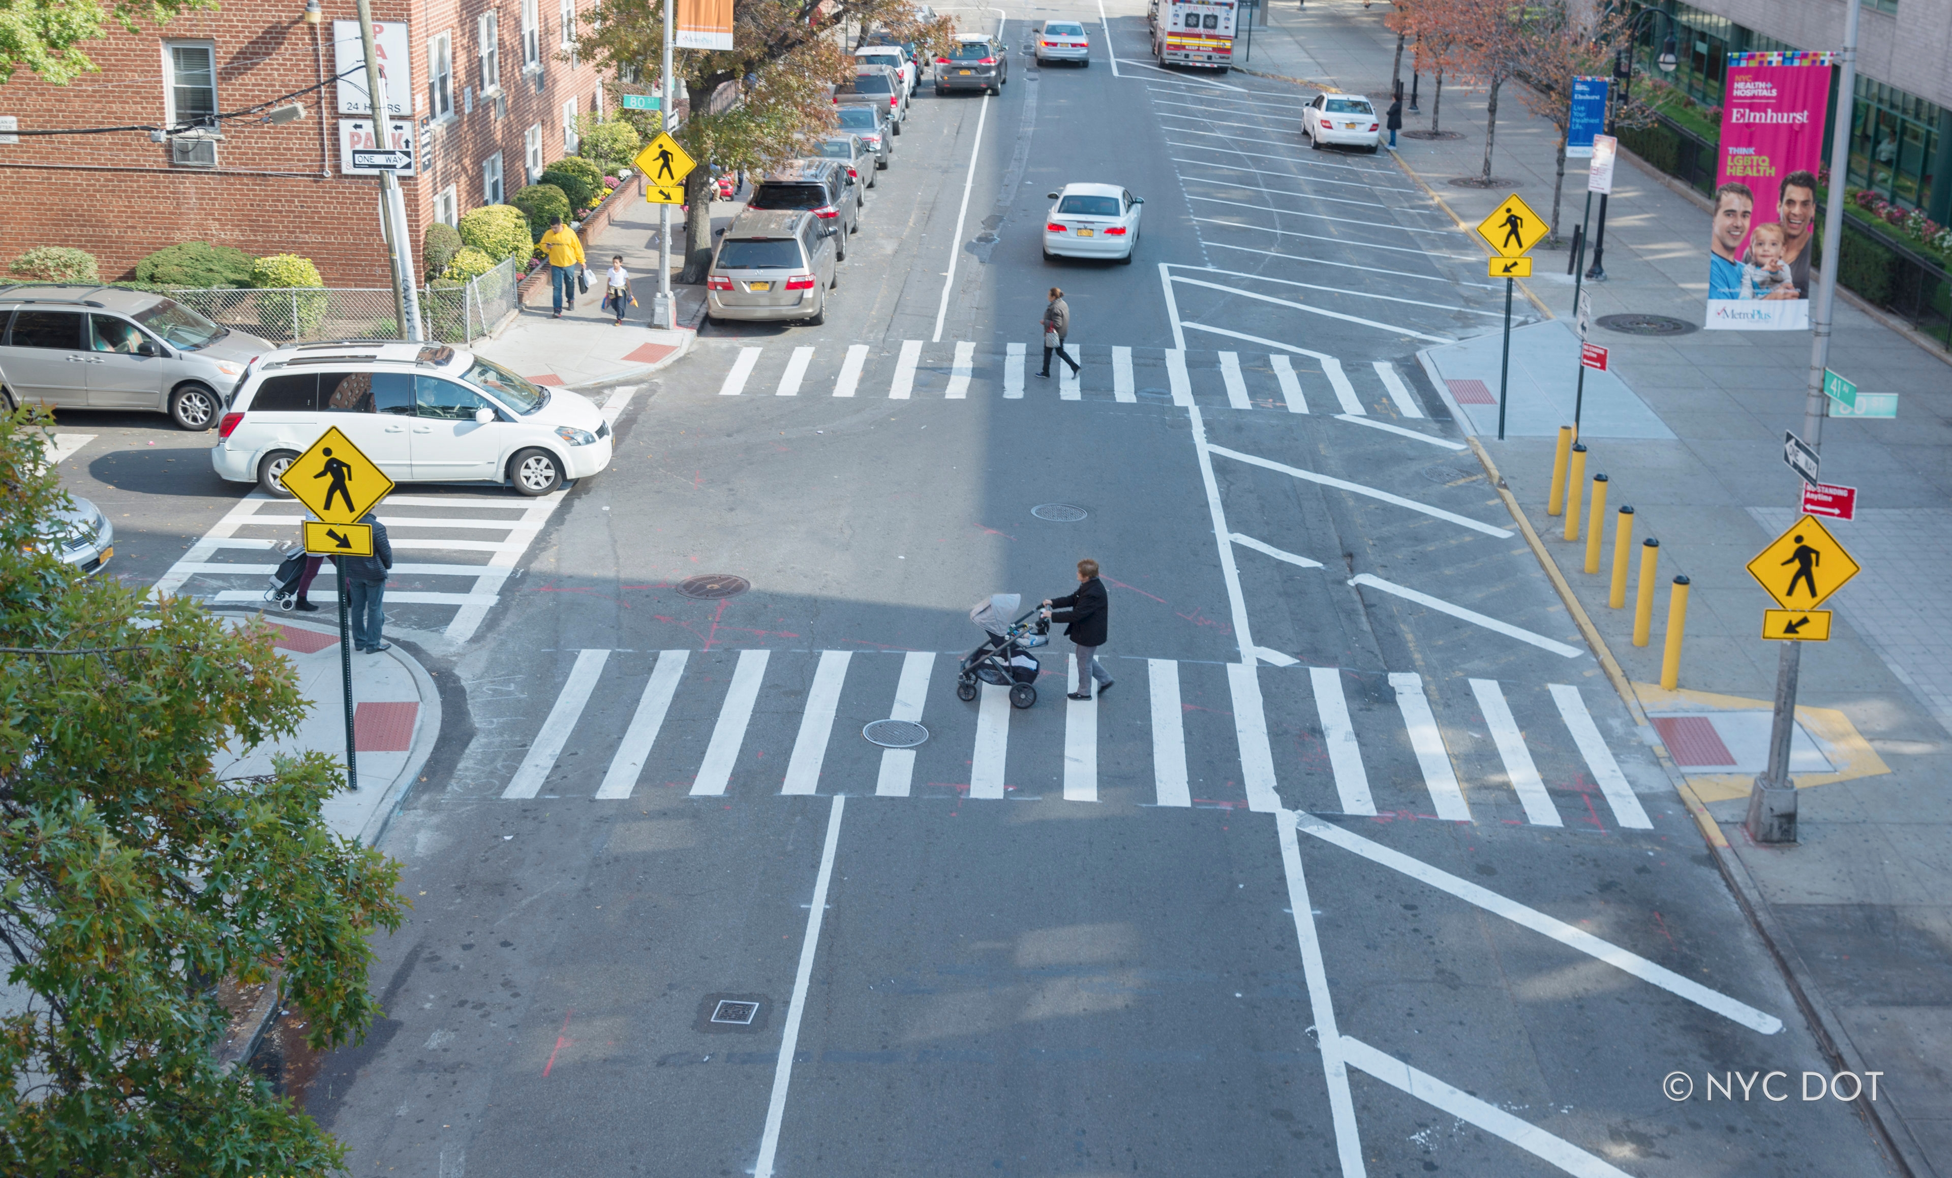
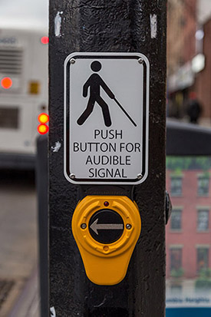
PROJECT Goals
Enhancing Pedestrian Safety
Improve pedestrian crossings at all intersections
Increase visibility and shorten crosswalks
Enhance bus-ridership safety with design improvements to bus stops
Install Accessible Pedestrian Signals (APS) to provide ADA compliant pedestrian access at all signalized intersections.
NYC Street Design Manual: Curb Extensions
5

Slide 6
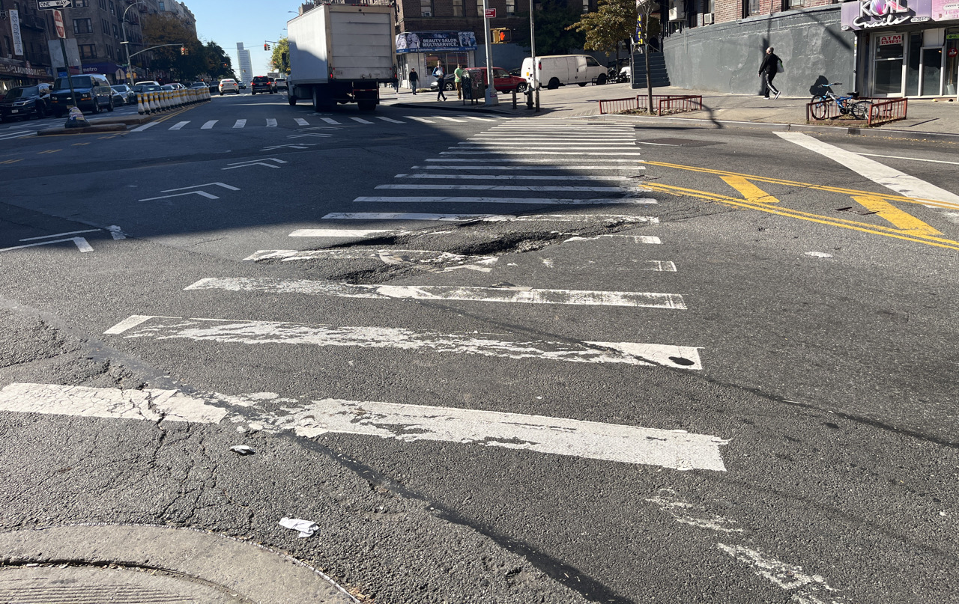
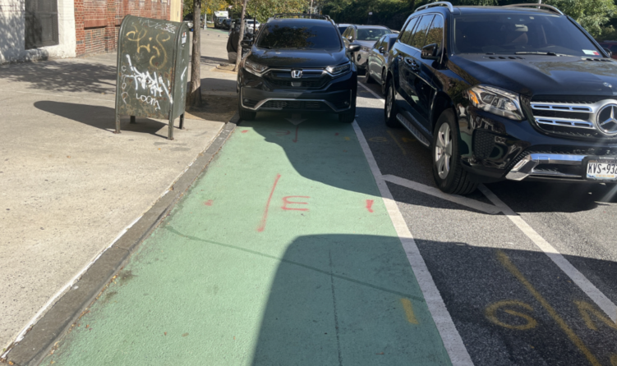
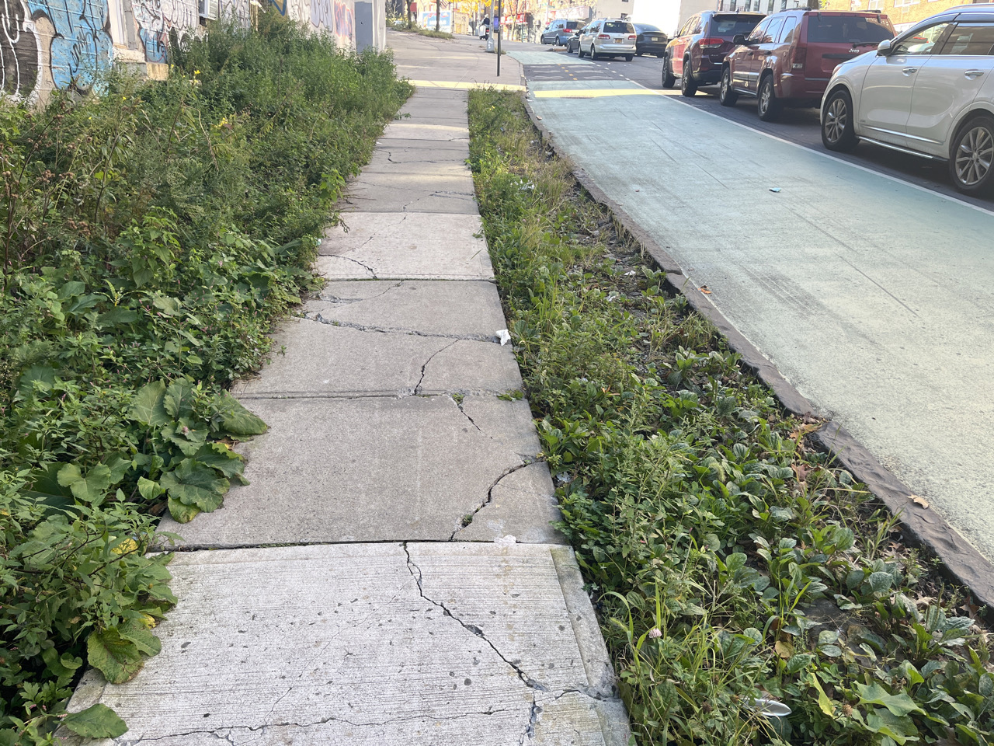
Existing site conditions
Site One, Fort George Multisite
Looking west towards the Fort George Multisite intersection, from the corner of Fort George Ave. and Fort George Hill.
Looking northeast from Fort George Hill, near the intersection of Fairview Ave. and Fort George Hill.
Looking southwest from Fort George Hill, towards the intersection of Fairview Ave. and Fort George Hill.
Repave cracked crosswalks
Prevent vehicles parked in bike lane
Fix uneven sidewalks
6
Notes:
Poor pedestrian infrastructure conditions and connectivity
Bicycle lane network lacks safety and efficient connectivity
Poor vehicle pavement markings and insufficient bike lane pavement markings
Cars park in bike lanes which is a safety hazard

Slide 7
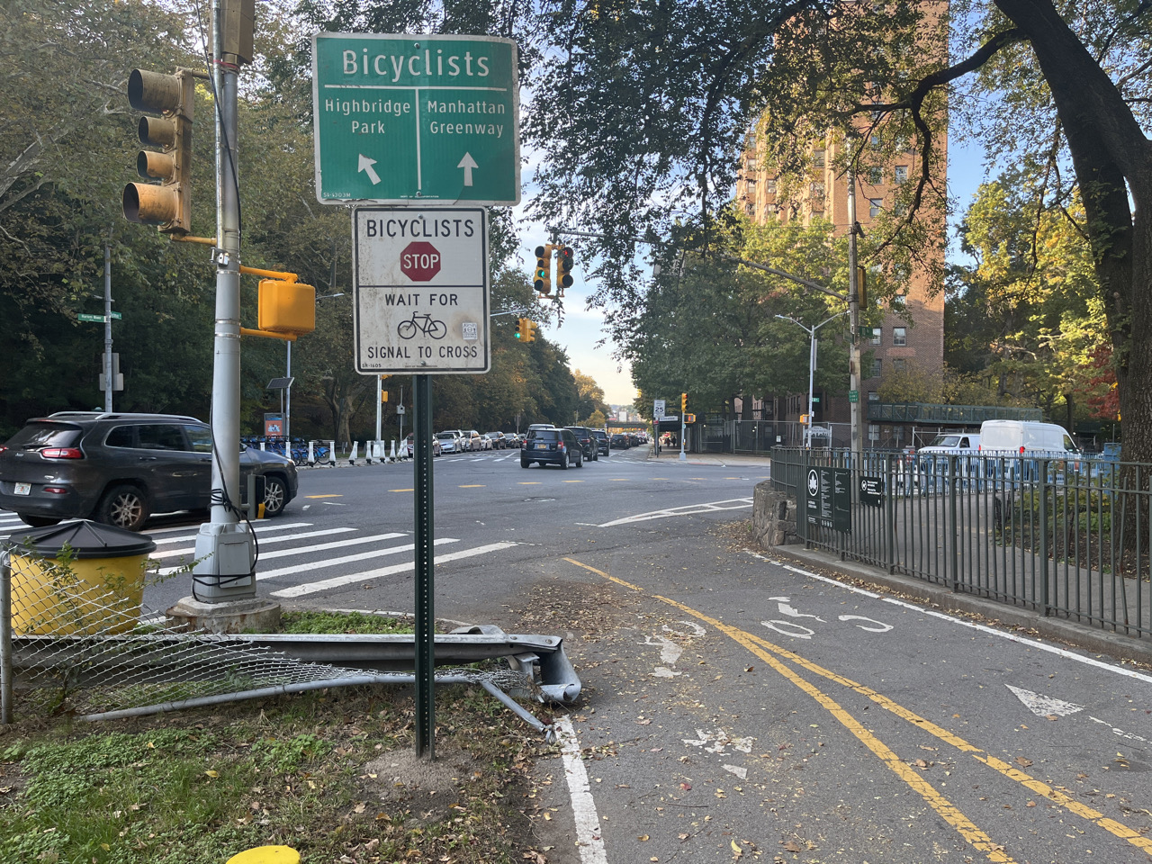
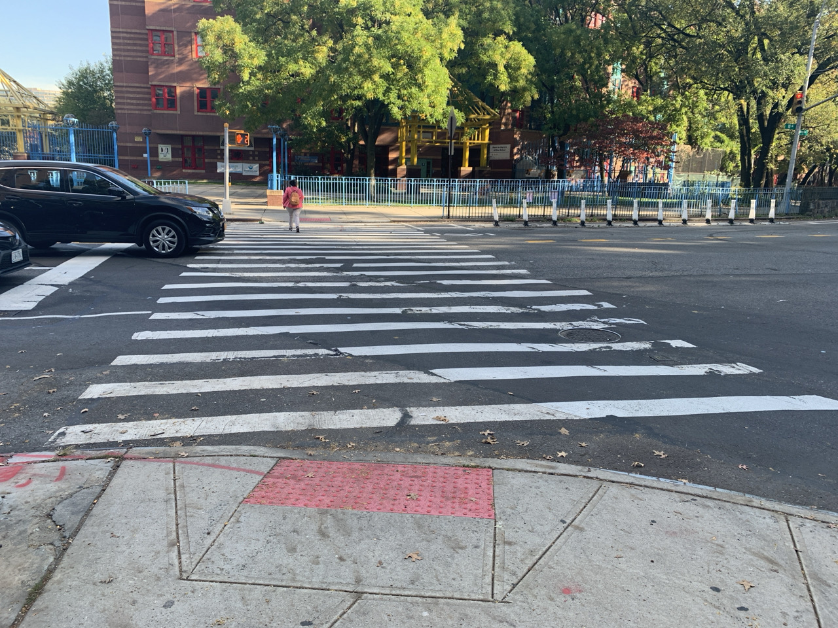
Existing site conditions
Site Two, Harlem River Drive Gateway
Looking west towards the Harlem River Drive Gateway intersection from the existing bike path.
Looking northeast towards Ellen Lurie PS 5 in front of Dyckman Houses at Harlem River Drive Gateway Intersection.
Shared space between pedestrians & cyclists
Adjustment required for misaligned crosswalk adjacent to Public School 5 – Ellen Lurie
7
Notes:
Poor pedestrian infrastructure conditions and connectivity
Bicycle lane network lacks safety and efficient connectivity
Poor vehicle pavement markings and insufficient bike lane pavement markings
Cars park in bike lanes which is a safety hazard

Slide 8
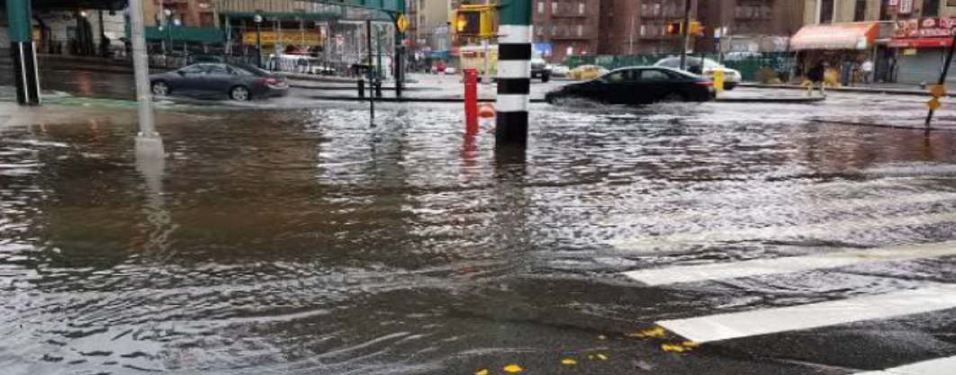
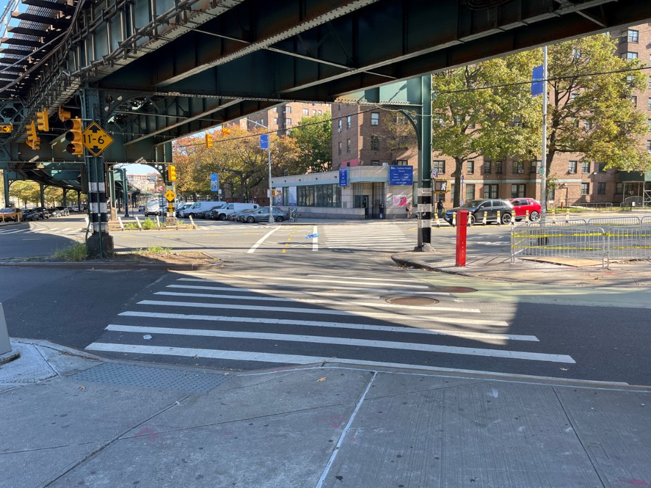
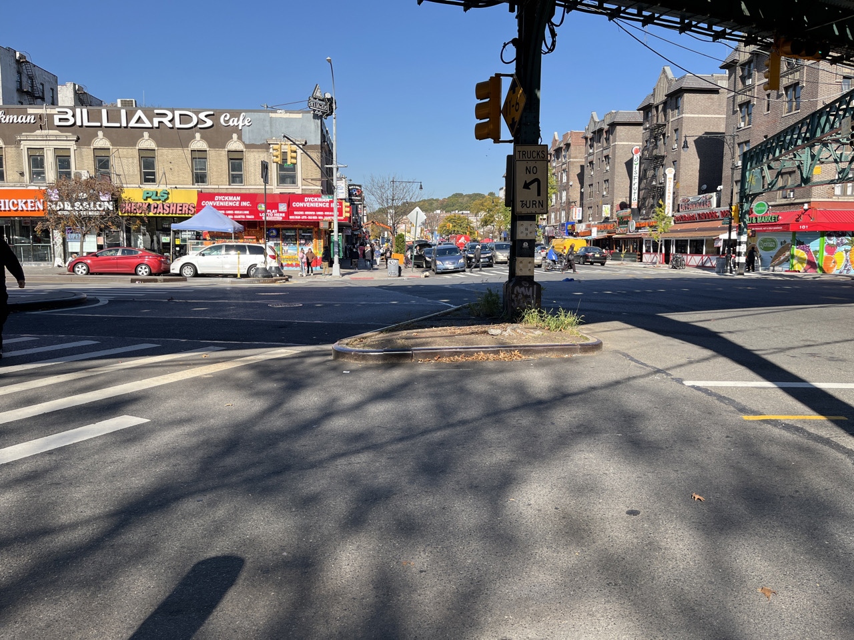
Existing site conditions
Looking north towards Dyckman Rest intersection from pedestrian island between Fort George Hill and Dyckman St.
Site Three, Dyckman Rest Intersection
Opportunity for drainage improvements during storm event
Looking north towards Dyckman Rest intersection adjacent to Gotham Health.
Improvements on long, misaligned crosswalks
Looking north towards Dyckman Rest intersection from pedestrian island between Fort George Hill and Dyckman St.
8
Enhance sidewalk space constraints
Notes:
Poor pedestrian infrastructure conditions and connectivity
Bicycle lane network lacks safety and efficient connectivity
Poor vehicle pavement markings and insufficient bike lane pavement markings
Cars park in bike lanes which is a safety hazard

Slide 9
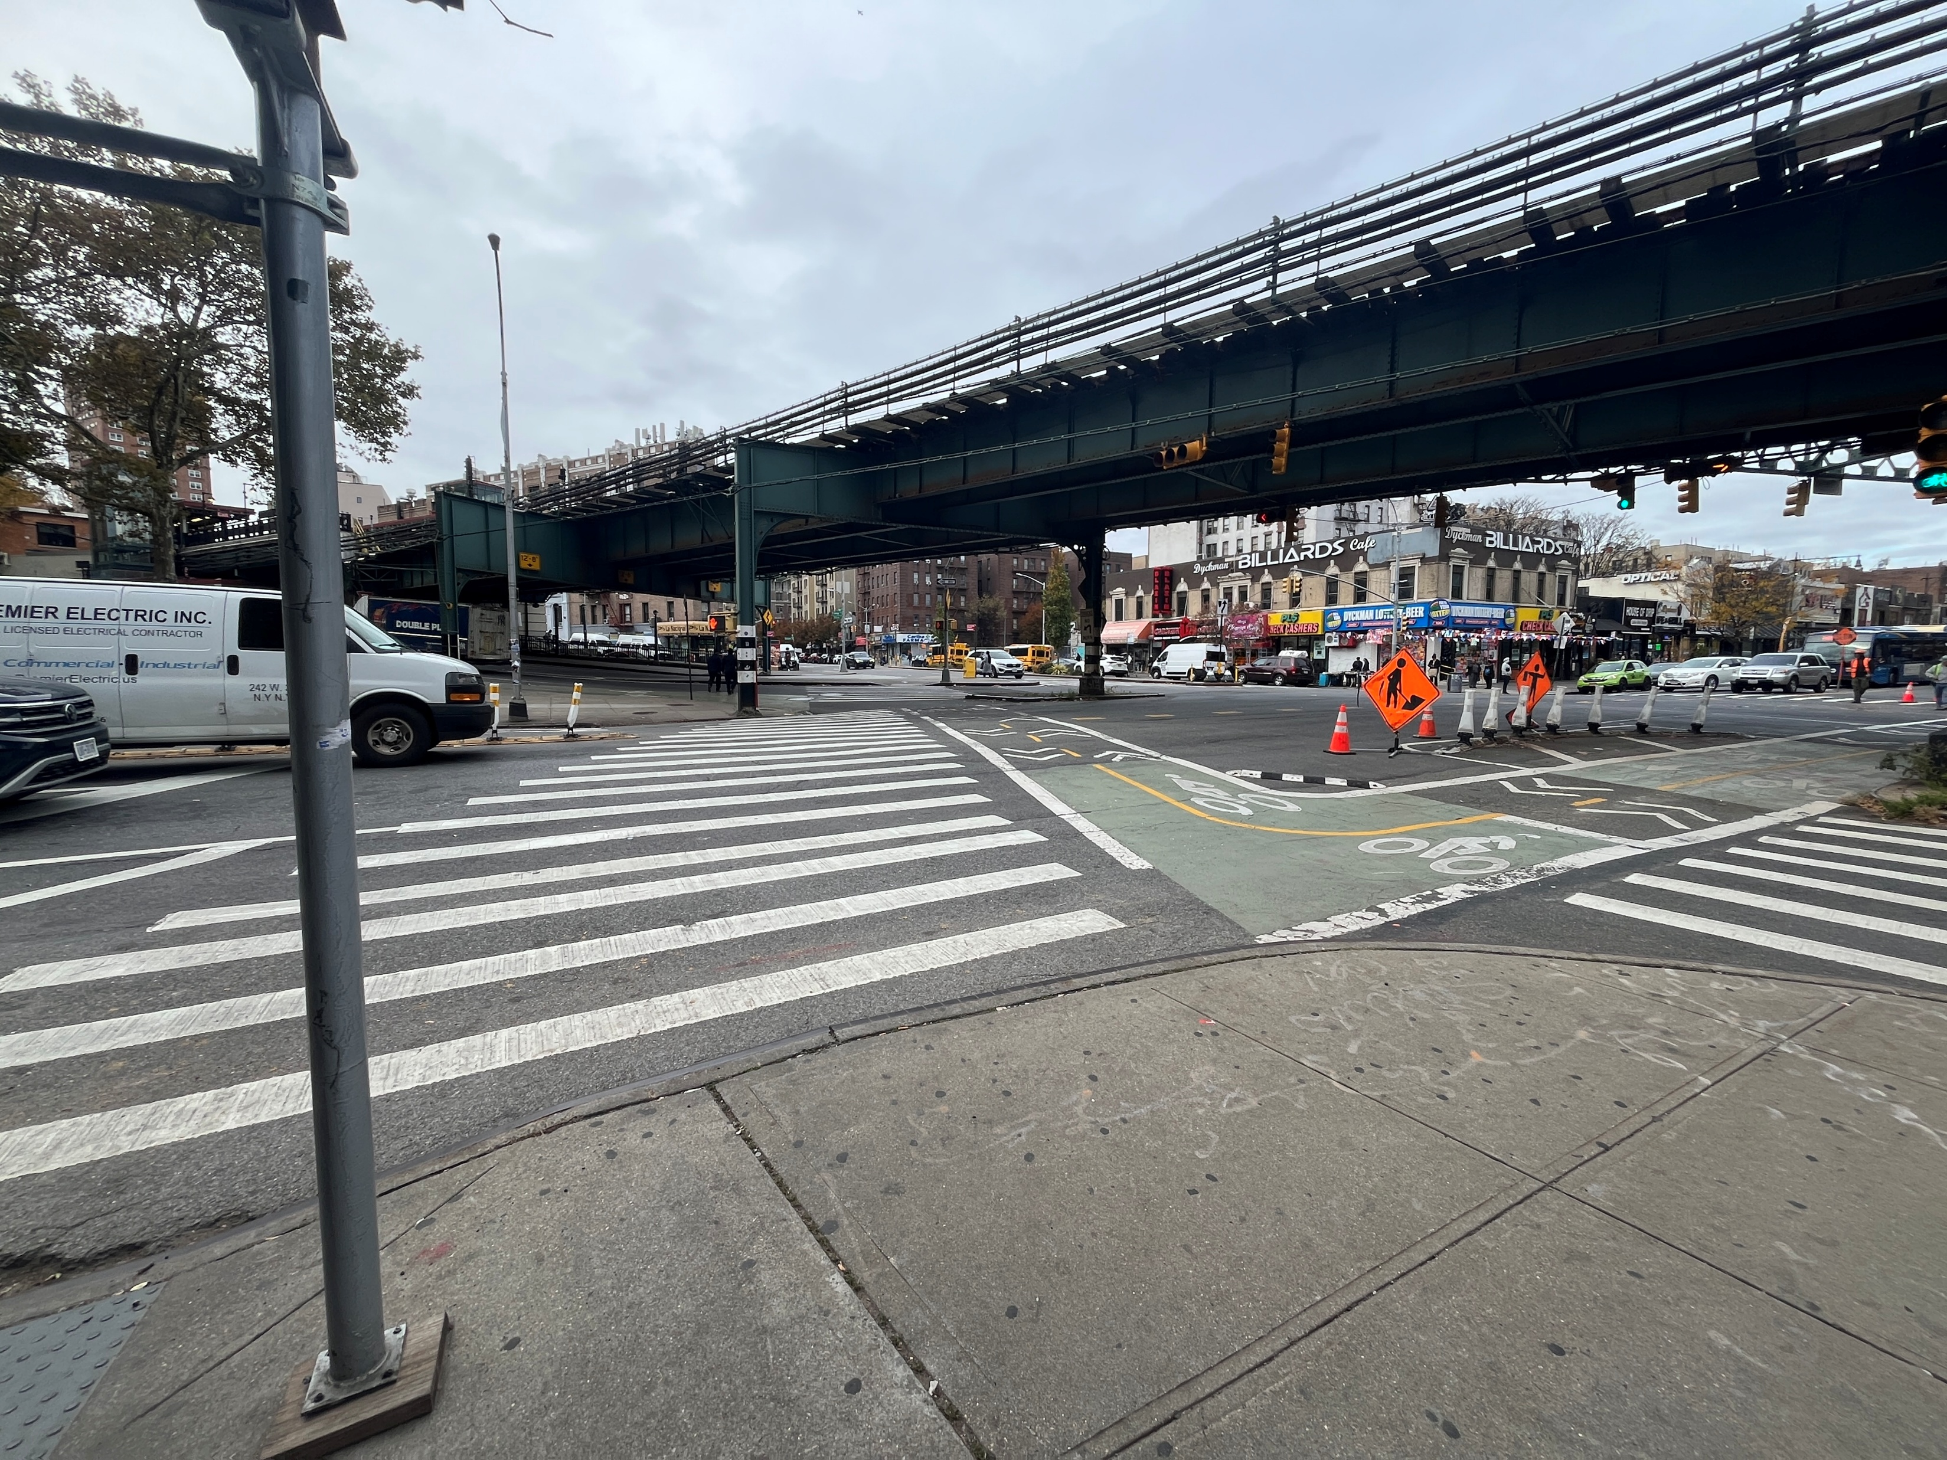
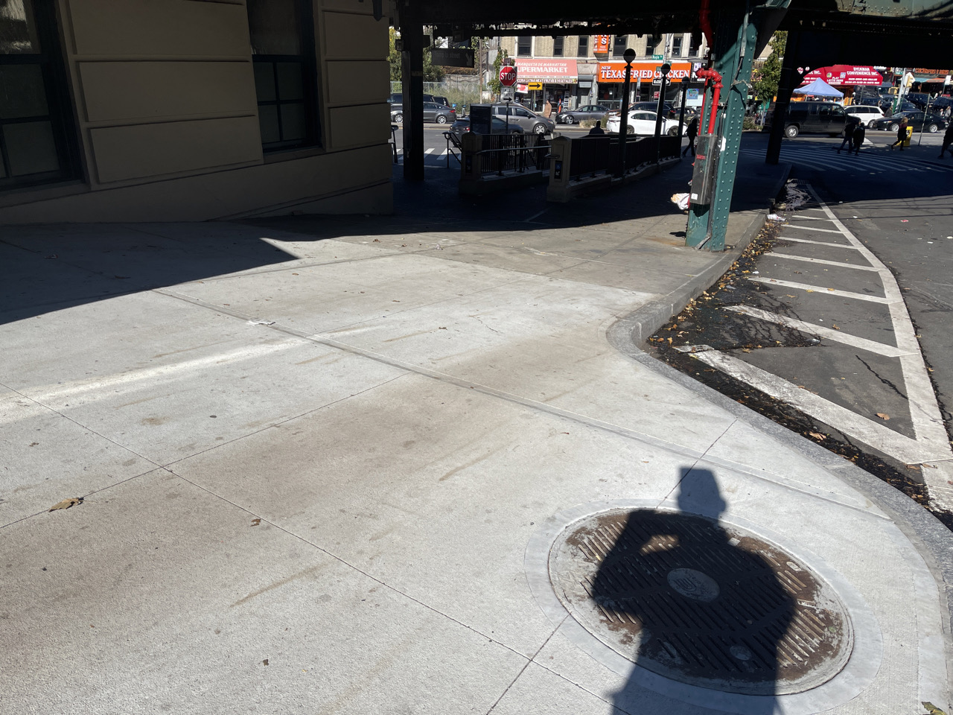
Existing site conditions
Site Four, Nagle Avenue Under the EL Structure
Looking northwest from the sidewalk adjacent to the bottom of Fort George Hill at the Dyckman St. 1-Train station entrance.
Looking west towards the Dyckman Rest intersection from the corner of Dyckman Street adjacent to Gotham Health.
  Improve unevenly distributed illumination areas with dark spots
9
Notes:
Poor pedestrian infrastructure conditions and connectivity
Bicycle lane network lacks safety and efficient connectivity
Poor vehicle pavement markings and insufficient bike lane pavement markings
Cars park in bike lanes which is a safety hazard

Slide 10
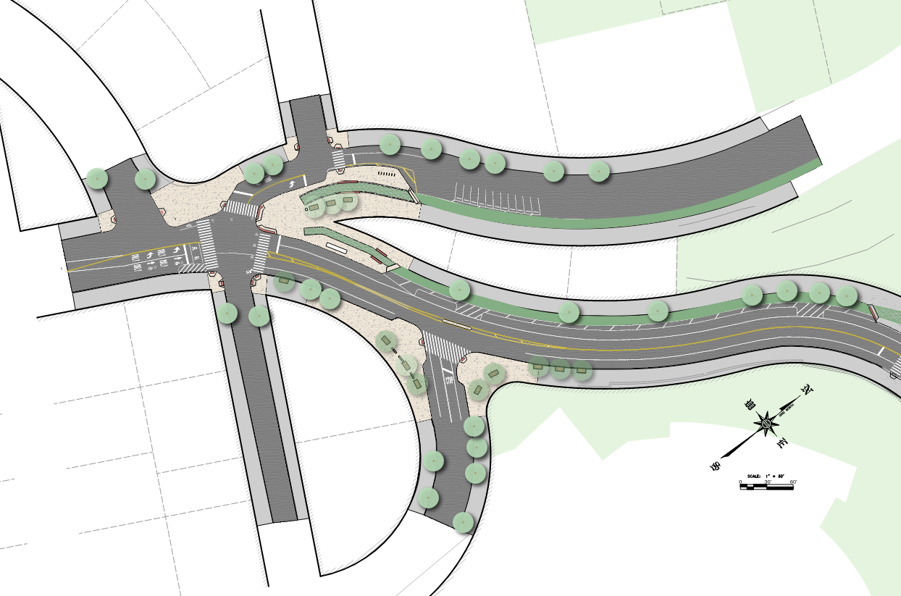
PROPOSED IMPROVEMENTS
Intersection of Fort George Hill, Fort George Ave., Fairview Ave., Wadsworth Ave., and W. 193rd St.
Proposed Sidewalk Extension
Protected Bike Lane
Site 1
NYCDOT City Racks
Proposed Sidewalk Extension
Wadsworth Ave.
Proposed Median
Fort George Hill
St. Nicholas Ave.
Fort George Ave.
Proposed Traffic Signal With APS and Street Lighting
Relocated Bus Shelter
Proposed Wayfinding Sign
W. 193rd St.
NYCDOT City Bench
Audubon Ave.
New Tree Plantings
10

Slide 11
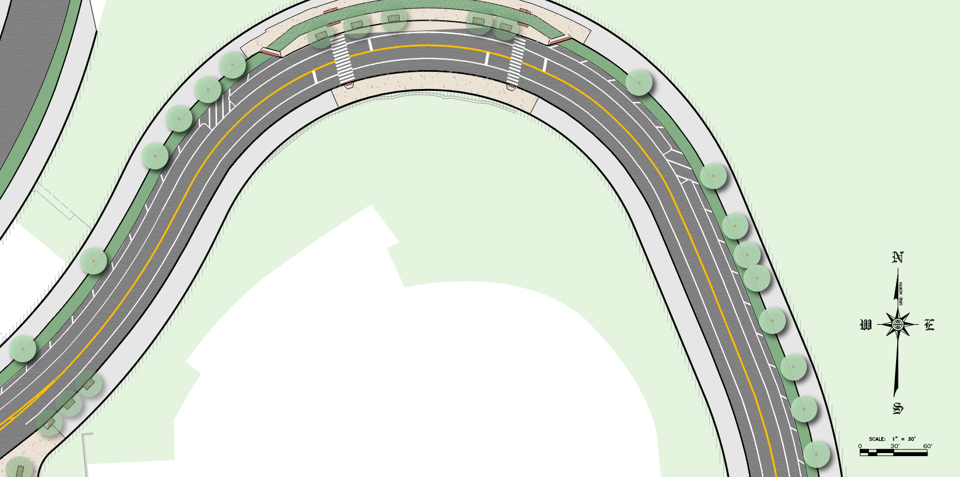
PROPOSED IMPROVEMENTS
Fort George Ave. between W. 193rd St. and Amsterdam Ave.
New Tree Plantings
Proposed Bike Lane
Site 1
New Pavement
Fort George Ave.
Proposed Traffic Signal With APS and Street Lighting
11

Slide 12
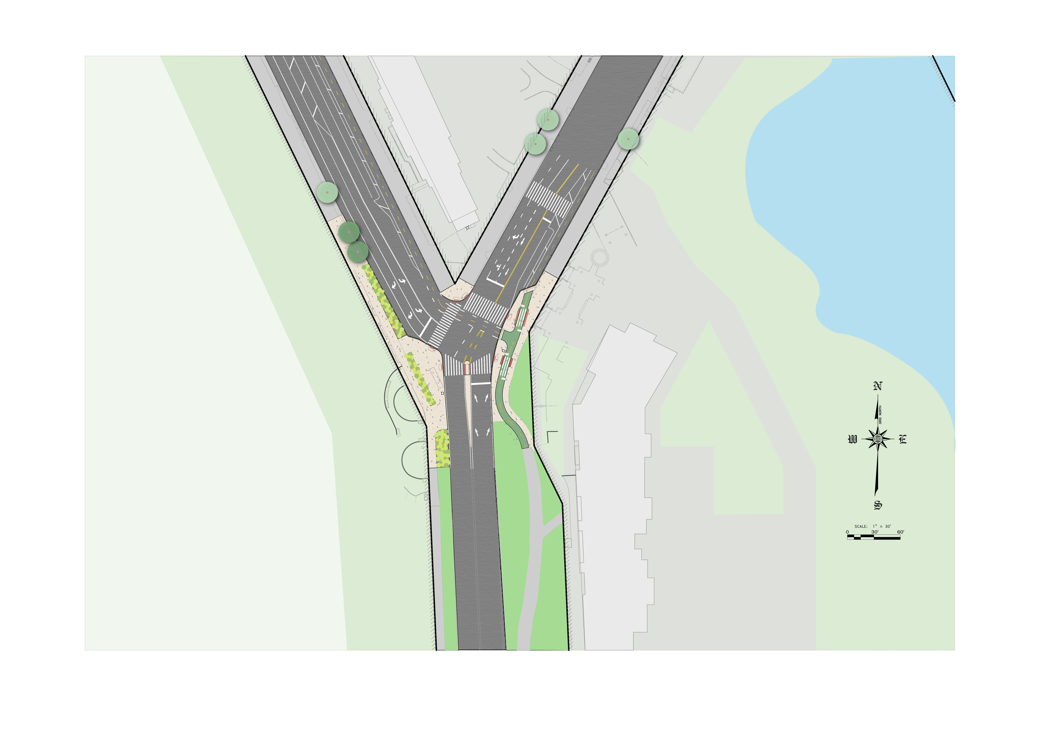
Proposed improvements
Harlem River Drive Gateway
Site 2
New Tree Plantings
Dyckman St.
10th Ave.
New Pavement
Proposed Wayfinding Sign
Proposed Traffic Signal With APS and Street Lighting
Proposed Bike Lane
Proposed Planting Areas
Relocated Citi-Bike Station
Proposed Wayfinding Sign
PS 5
Highbridge Park
Harlem River Dr.
12

Slide 13
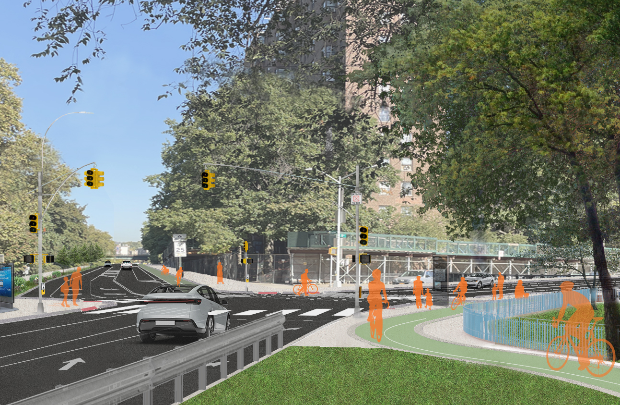
Proposed improvements
Harlem River Drive Gateway, Cont.
Site 2
New Plantings and Curb Extension
Ellen Lurie PS 5
Existing Bike Lane
New Bike Path at Pedestrian Grade
Dyckman St.
10th Ave.
Harlem River Dr.
Looking northwest from proposed bike lane towards the intersection of 10th Ave., Harlem River Dr., and Dyckman St.
13

Slide 14
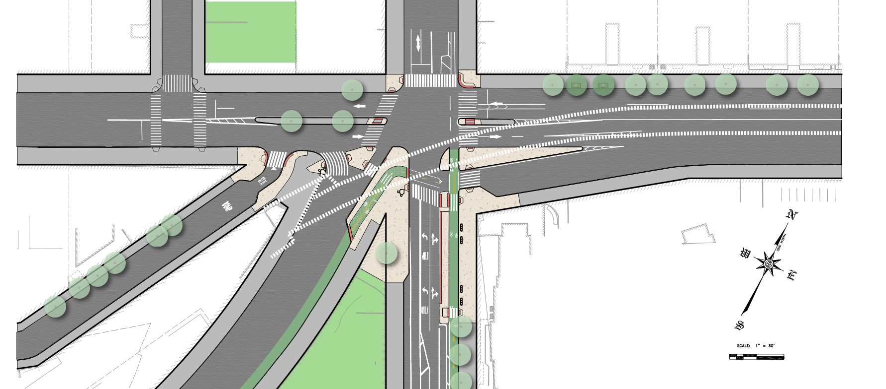
Proposed Improvements
Proposed Traffic Signal With APS and Street Lighting
Site 3
Dyckman Rest Intersection
New Tree Plantings
Thayer St.
Dyckman St.
Nagle Ave.
Nagle Ave.
New Pavement
Existing overhead MTA 1 Line
Proposed Wayfinding Sign
Proposed Wayfinding Sign
Hillside Ave.
City-EL Pilot Program
Protected Bike Lane
Relocated Bus Stop
Fort George Hill
NYCDOT City Bench
Highbridge Park
Dyckman St.
14

Slide 15
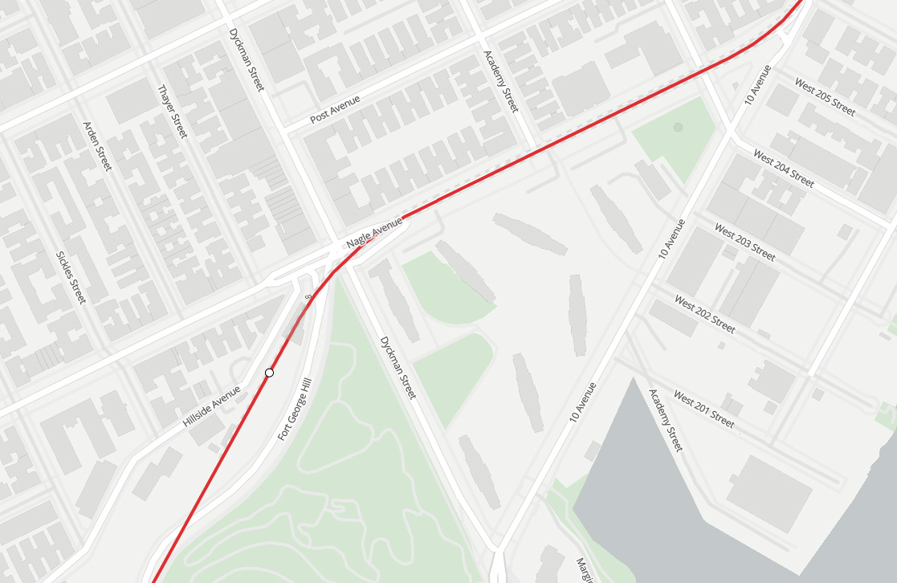
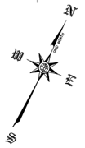
PROPOSED IMPROVEMENTS
Nagle Avenue, EL-Space Urban Design Corridor
Site 4
Enhance Electrical Service Point
for potential opportunities
Nagle Ave EL-Space Corridor
from Fort George Hill to W. 205th St.
15

Slide 16
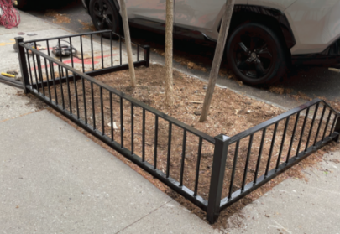
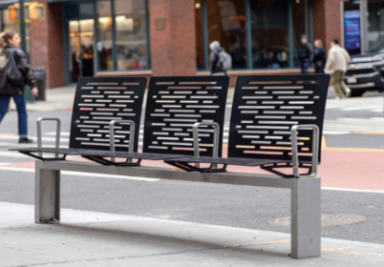
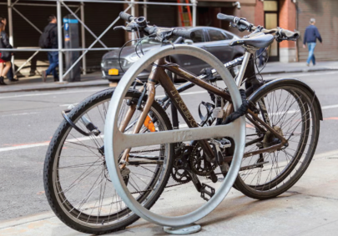
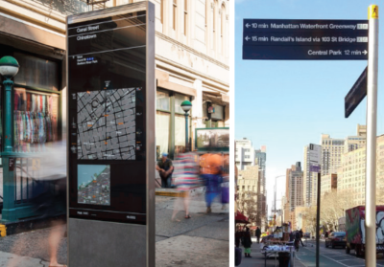
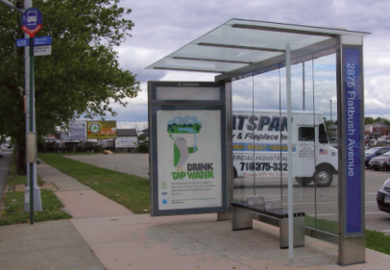
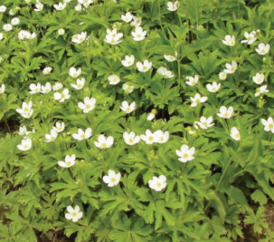
Proposed street elements
NYC Parks Tree Guard Type K
NYCDOT City Bench
NYCDOT City Rack
NYCDOT Wayfinding Sign
NYCDOT Bus Shelter
New Plantings
16

Slide 17
Tentative project Schedule
      Estimated timelines are subject to change as project is still in design:
Fall 2023 – Project Start
Winter 2024 – Preliminary Design Start
Winter 2025 – Preliminary Design Approval
Fall 2026 – Design Completion
Fall 2027 – Anticipated Construction Start
Spring 2030 – Anticipated Construction End
Spring 2026 – Community Board Presentation & Feedback

Slide 18
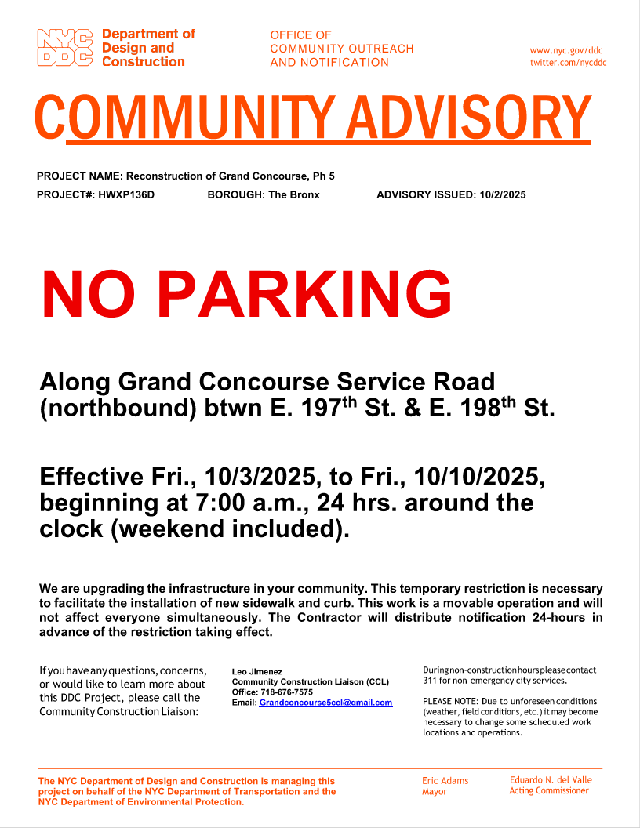
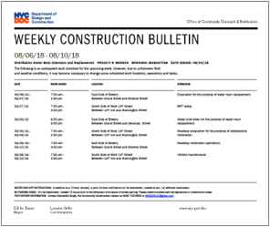
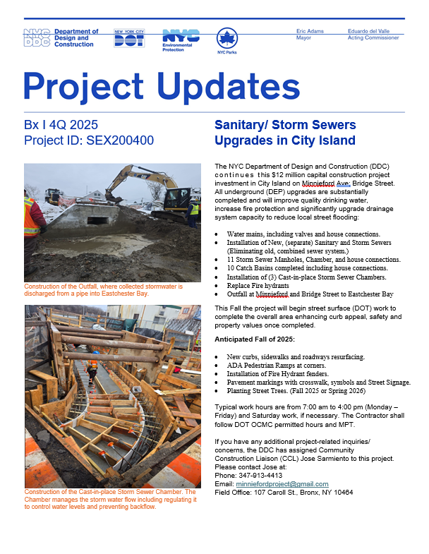
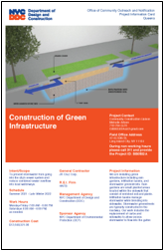
Community liaison involvement
Keeping You Informed.
The CCL addresses concerns, responds to inquiries, attends meetings as needed, as well as distributes project related materials to keep the community informed and notified.
PROJECT​
INFORMATION CARD (PIC)​
​ADVISORIES
WEEKLY ​LOOK AHEAD
BULLETIN
QUARTERLY ​
NEWSLETTERS​
18

Slide 19
Questions & open discussion
Thank you

